Slide 1

Interview and its various Types

Slide 2

What is an interview?
The term interview has been derived from the French word entre voir that means to glimpse or to see each other.
By definition it means a meeting for obtaining information by questioning a person or persons.

Slide 3
Interview as defined by The Oxford Advanced Learner’s dictionary
A formal meeting at which somebody is asked questions to see if they are suitable for a particular job or course of study of a college/university.
Private meeting between people where questions are asked and answered.
To ask somebody about their life, opinions especially on radio or television or for the newspaper or magazine.
To give an interview is to agree to answer questions.

Slide 4
Meaning of the term ‘Interview’
Basically ,an interview is a conversation between two people (the interviewer and the interviewee) where questions are asked by the interviewer to obtain information from the interviewee.
The word interview can have different meanings. For example a reporter interviews a celebrity for television. This kind of interviews can be one-on-one but usually when it comes to television there are many reporters from different channels.

Slide 5
There are also job interviews which a person has to go through in order to get a job he wants. Job interviews are usually face-to-face interviews and include paperwork.
During an interview you can expect to be asked questions about your educational background, previous work experiences and questions relating to your personal characteristics and goals. But what happens after that? It depends on what interview style your interviewer prefers. Below are some of the more common interview styles used.

Slide 6
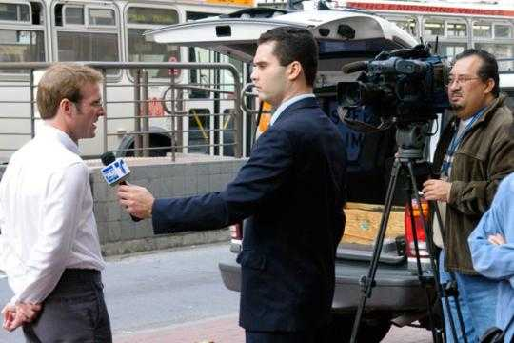
The Purpose of an Interview
An interview has two
purposes :-
To find if the candidate has the right attitude and fits the requirement and company culture
To find the best candidate to fill a vacancy

Slide 7
Interviews
ADVANTAGES
Deep and free response
Flexible, adaptable
Glimpse into respondent’s tone, gestures
DISADVANTAGES
costly in time
and personnel
impractical with large numbers of respondents
requires skill
Ability to probe, follow-up, clarify misunderstandings about questions
possible biases: interviewer, respondent, situation
may be difficult to summarize responses

Slide 8
What does an interviewer look for ?
Who you are as a person
Your knowledge
Your skills
Your attitude
Your ability to interact with people
Your capacity to take work pressure

Slide 9
Types of Interviews
BASIS
CLASSIFICATION ACCORDING TO STRUCTURE
CLASSIFICATION ACCORDING TO THE PURPOSE
CLASSIFICATION ACCORDING TO INTERVIEW’S CONTENT
CLASSIFICATION ACCORDING TO ADMINISTERING THE INTERVIEW

Slide 10
I. CLASSIFICATION ACCORDING TO STRUCTURE
1. STRUCTURED OR DIRECT INTERVIEW
The questions and acceptable responses are specified in advance
Responses are rated for appropriateness of content
Also called standardized interviews as they are pre planned to a high degree of accuracy and precision

Slide 11
2. UNSTRUCTURED OR INDIRECT INTERVIEW OR OPEN-ENDED INTERVIEW
Not directed by questions or comments as to what the candidate should be asked
No set format is followed
Candidate is encouraged to express himself on any topic of his interest, his expectations, background etc.
Interviewers look for traits of character and nature of his aspirations, strengths, weaknesses, potential etc.

Slide 12
3. SEMI-STRUCTURED INTERVIEW
specific topic areas
a general set of questions
but the interview flows like a conversation and topics are covered as they come up.

Slide 13
Pros and Cons of Structured & Unstructured Interview
STRUCTURED INTERVIEWS
More reliable and valid as all candidates are asked the same set of questions
Enhance consistency across candidates
UNSTRUCTURED INTERVIEWS
Flexibility to pursue points of interest as they develop
Help in assessing the clarity of thoughts of the candidate

Slide 14

II. CLASSIFICATION ACCORDING TO PURPOSE
1. STRESS INTERVIEW
This type of interview is rare
in the present job scenario.
It was a very common
interview method when
selecting for sales position.

Slide 15
Stress interview means-
Being asked more than one question at a time;
Being asked further questions without being allowed adequate time to respond;
The interviewer adopts a hostile behavior and deliberately puts the candidate on defensive by trying to annoy, embarrass or frustrate him;
He asks questions rapidly, criticizes his/her answers, interrupts him/her frequently, makes derogatory remarks etc.
Having his/her feelings provoked.

Slide 16
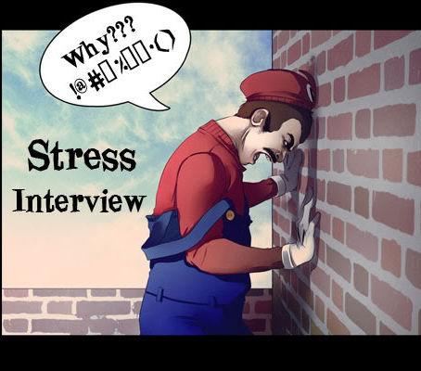
Why stress interviews?
This interview is an attempt to see how the candidates handle themselves under stress.
So, the interviewer deliberately assumes a sarcastic or argumentative position.
The trick for the interviewee is to remain calm under such a situation.

Slide 17
2. APPRAISAL/ ASSESSMENT INTERVIEW
A discussion following a performance appraisal
In which the supervisor and employee discuss the employee’s rating and
Possible remedial actions to be taken.

Slide 18
3. EXIT INTERVIEW
When an employee leaves the company for any reason, an exit interview is conducted
Aims at eliciting information about the job or related matters
Help the employer in having a better insight into what is right or wrong about the company
Highlights the work of an HR Manager

Slide 19
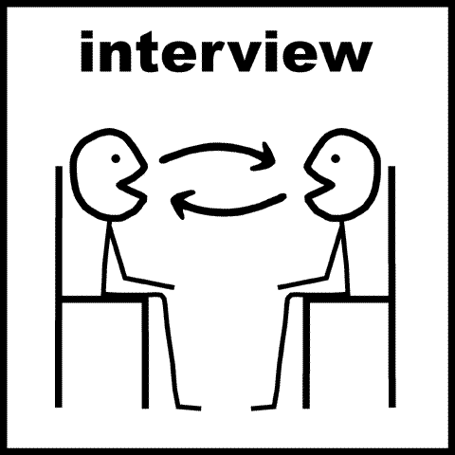
III. CLASSIFICATION ACCORDING TO ADMINISTERING INTERVIEW
ONE TO ONE INTERVIEW
Single interviewer
who takes interview
one by one
Maybe structured, unstructured or sequential
Easier to handle, generally more informal
Best way to handle such interviews is to relate them as a form of a conversation

Slide 20
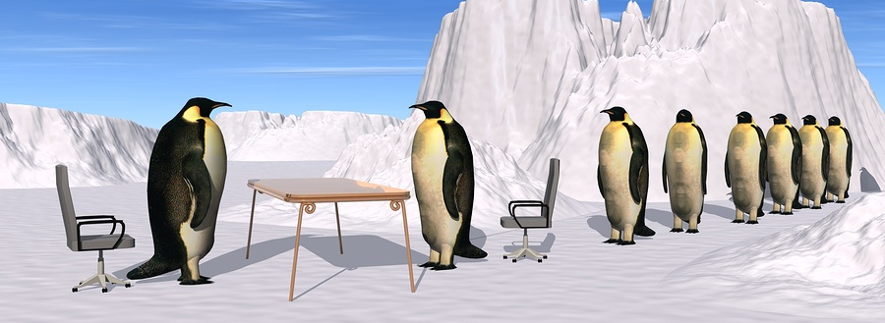
2. SEQUENTIAL/SERIAL INTERVIEW
These interviews are
Those in which the
applicant is interviewed
Sequentially by several
persons (interviewers)
Each one rates the applicant on a standard evaluation form and these ratings are then compared before the hiring decision is taken
Each interviewer rates from his/her own point of view, asks different questions and forms an independent opinion of the candidate

Slide 21

3. GROUP INTERVIEW/ GROUP DISCUSSION
The main purpose of this
interview is to see how
the interviewee interacts
with others and how he/
she influences others with
his/her knowledge and
reason.
Also known as GD’s, a topic for discussion is given to a group.

Slide 22

Why group interviews?
Group interview is also the best
way to discover any leadership
potential, group participation, team
playing skills and communication
skills among the candidates.
The selected candidates from the group interview are then taken for an informal one to one interview.

Slide 23
4. PANEL INTERVIEW/ COMMITTEE INTERVIEW
A panel interview comprises more than two members interviewing a person for the hiring.
It is most common mode of interview when hiring at the senior level.
The interviewee should try to connect with each interviewer and the best way to do this is to read the personality of each interviewer.

Slide 24

In a panel interview,
the interviewer tries
to gauge the group
management and group presentation skills of the interviewee.
The interviewee should maintain eye contact with the person asking the questions but also seek eye contact with the other members of the panel.

Slide 25
IV. CLASSIFICATION ACCORDING TO INTERVIEW’S CONTENT
1. SITUATIONAL INTERVIEW
Here the interview will focus on the individual’s ability to project what his behavior will be in a given situation.
The interview can be both structured and situational with predetermined questions requiring the candidate to project what his behavior will be.

Slide 26
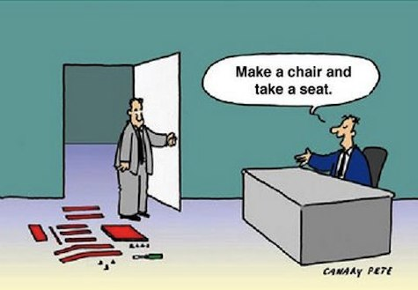
2. JOB RELATED INTERVIEW
Here the interviewer
tries to deduce what the
applicant’s on-the-job
performance would be,
based on his answers
about his past behaviors.
Job related questions are asked to draw conclusions about the candidate’s ability to handle the job to be filled.

Slide 27
3. BEHAVIOURAL INTERVIEW
Here a situation is described and candidates are asked how they have behaved in the past in such a situation.
While situational interviews ask candidates to describe how they would react to a situation in future,
The behavioral interviews seek candidates to describe how did they react to situations in the past.

Slide 28
4. PSYCHOLOGICAL INTERVIEWS
Psychological interviews are interviews conducted by a psychologist,
In which questions are intended to assess personal traits such as reliability or dependability etc.

Slide 29

SOME MORE TYPES :-
TELEPHONE INTERVIEW
Phone interviews are
increasingly used in
mass hiring.
The interview is conducted entirely over the phone and this is very effective in eliminating any bias that may arise from the appearance and manner of the candidate.

Slide 30
PROMOTION INTERVIEW (of the employees who are due for promotion)
ANNUAL INTERVIEW (before writing annual reports, reporting officer interacts with employees subordination)
PERIODICAL INTERVIEW (with the existing employees)
PROBLEM INTERVIEW (of an employee whose performance is unsatisfactory-to find out reasons and find solutions)
COMPUTERIZED INTERVIEW (questions are presented in MCQs)
WALK-IN INTERVIEW (no specific candidates are called, but those who are eligible can come with their valid documents)
VIDEO CONFERENCING (using video technology; clothing, body language and dialogue are important here as well)
CASE INTERVIEW (to solve problems ‘on the spot’)

Slide 31
FACTS YOU SHOULD KNOW ABOUT THE COMPANY
About the company, history, employment and position in the industry
Competitors
Products and services
Global presence
Publications, blogs, presence in social media, analysts’ review
Finances of the company
The position you have applied for
Requirements of the specific position

Slide 32
Continued-
Job profile
Growth opportunities
Salary offered for the role
Requirement of travel
Working hours to be put in
Qualifications and any technical skills required

Slide 33
DOs and DON’Ts for an interview
DOs | DON’Ts
Groom yourself well | Do not demonstrate overconfidence
Show enthusiasm | Do not answer before the question has been completed
Carry extra copies of your resume | Do not talk continuously
Wear a cheerful smile | Do not be rude or get into an argument with the interviewers
Be polite, assertive and firm | Do not fiddle with your tie or pen
Be genuine and truthful when you reply | Do not extend your hand first for a handshake
Look into the eyes of the interviewer while talking to him/her | Do not be unclear about your expectations from the job

Slide 34
QUESTIONS YOU MUST PREPARE FOR..
Tell me something about yourself.
What are your hobbies ?
Why did you do your MBA after graduation ?
Which is the most recent book that you have read ?
Have you heard about …. (a current topic) ?
What will you do if you reach office one morning and find out that you have lost your job ?
What was your role in your previous company ?
Where do you see yourself two years down the line ?
What are your expectations from the job ?
What are your strengths and weaknesses ?
Give us an example of an adverse situation at work and how you tackled it ?

Slide 35
FOLLOWING UP
The last logical step after an interview.
It has mainly two purposes.
(i) to demonstrate good etiquette
(ii) to give a gentle reminder to the interviewer
Follow-up should be done either over phone or email.

Slide 36
THANK-YOU NOTE
It is generally written in a positive and direct tone to the interviewer. Its purpose is to express gratitude for the interview’s time and for giving a positive impression about you at the interview. You can say that you are hoping for a quick decision from them.
It is also written after you have received the offer letter.
INQUIRY
There could be a situation when you were confident that you would be selected but have not heard from your prospective employer. If you have not heard from an interviewer, you can raise an enquiry. Adopt a direct approach for such correspondence. Try and restrict yourself to two paragraphs- neither too long, nor too short.

Slide 37
LIMITATIONS OF INTERVIEWS
Personal Bias
The Halo Effect
Constant error
Leniency
Projection
Stereotyping
Snap judgement
Lack of Integration
Pressure to Hire
Too much/ Too Little Talking

Slide 38
CONCLUSION
The candidate has to physically and emotionally be prepared apart from being knowledgeable in the domain area.
Many of the recruiters believe in recruit for attitude, train for skills.
Apart from a pleasing personality, grooming and effective communication play a vital role in succeeding at interviews.

Slide 39

Thank you!

